Slide 1
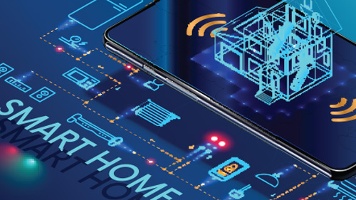
Smart Home
By
Team exemplary
Neaz Mahmud
Asm Nurussafa
Tasawar Siddiquy
Credit: Andrey Suslov/shutterstock.com

Slide 2
Disadvantages
Of Current Smart Homes

Slide 3
Significant installation costs As we can see from the previous analysis, smart homes can be a great way to facilitate our daily life. However, there are also some problems related to smart homes. One disadvantage of smart homes is that they can be quite costly. There might be significant installation costs which may amount to many thousands of dollars. Depending on the quality of the system, there might be even no limit and many people might not be willing to spend this kind of money on their smart home. However, smart homes can also save you money in the long run due to energy savings. Thus, if you consider engaging in smart home devices, you should also take into account the long-term benefits, not only the high initial costs of this technology.

Slide 4
Unreliable internet connection Another downside of smart homes is that they need a reliable internet connection to work properly. For instance, if you live in an area where the internet connection is rather poor, you might experience serious issues since your smart home devices might not respond the way you want them to. Moreover, if you want to control your smart home device from your work or from other remote places, you might not be able to do so since you might not be able to connect with your devices in a sufficient manner.

Slide 5
Security issues There might also be some security issues associated with smart home technologies. For example, burglars could hack into your smart home system and open the lock in order to get access to your home. Moreover, hackers may also steal your data. Thus, even though smart homes are quite convenient, there are significant security issues related to them and you should be aware of those issues if you plan to invest in smart home devices.

Slide 6
Cyber Threat It’s impossible to discuss smart home technology without touching on the issue of cybersecurity and all of the various consequences that come with it. It’s a serious topic that deserves serious attention. According to Rambus, an estimated 80 percent of IoT devices are vulnerable to a wide range of cyber attacks. Connecting these devices – which most people do within the smart home – only amplifies the risk by creating a web that hackers can use to “enter” into homes and compromise privacy or steal data. Think of it like a line of dominos. Once one device is tripped, the rest can easily be knocked down as well. Device hijacking is one common method. Other common cybersecurity threats within the smart home include man-in-the-middle attacks, distributed denial of service (DDoS), and Permanent Denial of Service (PDoS). These attacks can result in data theft, identity theft, and even a loss of physical privacy (when cameras and microphones are involved).

Slide 7
Technological problems in connected homes Another issue with smart homes is that they are rather complex technological systems and therefore quite vulnerable to technical problems. For instance, if there are connection problems from your smartphone to your household devices, chances are that you will no longer be able to control your smart home device anymore. Even though technology progresses and becomes better over time, technological issues might still be a problem and nothing works 100% of the time.

Slide 8
You may lock yourself out of your own house If your smart home system has been set up in a quite poor and incompetent manner, you might even lock yourself out of your own home. For instance, if the voice system will not be able to recognize your voice anymore, you may not be granted to access your house and you might have to call an expert to open your door instead, which can be quite costly, especially on weekends or at late hours.

Slide 9
Helplessness if technology fails Our technological progress can be considered to be a good thing since it can improve the quality of life of everyone of us. However, there are also some problems related to technology. For instance, you might be quite helpless if your smart home technology fails. Since you always relied on this technology to work and adapted your behavior, you might feel lost in case your smart home technology will not work anymore. Thus, excessive reliance on those technologies might not be a good thing and you should always stay independent enough to handle your life, even if your smart home devices fail.

Slide 10
Some people may not like smart technologies Many people also just don’t like the idea of a smart home. Especially the older generation is often quite skeptic about it. Since we often hear about weaknesses of those systems which make it easy for burglars to get into our home, many people may refrain from those smart home technologies and rather rely on their old-school locks, even if those locks are also quite unsafe.

Slide 11
Maintenance and repair issues Smart homes may also imply some problems when it comes to maintenance or repairs. Especially if you live in remote rural areas, you might have a quite hard time to find someone who has the expertise to fix issues with smart homes. Many handymen are not skilled enough in this field yet and finding an export to fix those smart home technologies might not be easy. In the worst case, you might have to fix those issues by yourself, which would imply that you have to spend long hours learning all the technological stuff yourself.

Slide 12
Some initial learning efforts necessary Even if the smart home system works properly, there is still some learning required from your side in order to manage your home from just one single device. In the first days, you might feel a little bit overwhelmed. However, you will quickly get used to the new functions that are available to you and over time, controlling your household devices with your smartphone will be no big deal anymore.

Slide 13
Compatibility problems between devices Even though the idea behind smart homes is to have one single program that allows us to connect to all of our smart devices, there are some compatibility issues in real life. For instance, some household devices may require app A while others may require app B. Thus, you might need to use a variety of apps to control all of your devices, which may be rather inconvenient and exhausting in the long run.

Slide 14
Surges are possible Due to the interconnectedness of those household devices, also the probability of surges increases. If your home is not protected properly, this may increase the chance for fires and in the worst case, your house may burn down due to the use of too many smart household devices at the same time.

Slide 15
Smart home technology not suitable for all houses Depending on how old your house is, it may not even be suitable for smart home technologies since those technologies often require a certain wiring and many old buildings do not have proper wiring in this regard. Thus, before you decide to install smart home devices, make sure that your home is actually suitable for it.

Slide 16
Technology may become outdated soon Another disadvantage of smart homes is that the technology that is used may become outdated soon. Our technological progress is astounding and things that seemed to be impossible may become possible in just a few years due to artificial intelligence and machine learning. Therefore, if you install a smart home right now, chances are that you will not be up to date a few years from now and that you may have to make plenty of adjustments over time.

Slide 17
Privacy concerns Critics of smart homes also often claim that there might also be significant privacy issues related to the use of smart home technologies. For instance, if you use a smart voice recognition system, your data may be gathered by those companies and you may not know what happens with this data and for what purposes it may be used. Therefore, there are also some privacy concerns related to smart homes and you should evaluate yourself if you want to risk giving away your data to third parties.

Slide 18
Architectural Overview

Slide 19
Ideas and sketches

Slide 20
Smart Windows:
Smart windows will be automatically closed in case of extreme weather or rain. This is can be user-preference based, the user can set a temperature; depending on which the AC or heater will be automatically activated/ deactivated.
Requirements : Windows, Micro-controller, AC, Wifi.

Slide 21
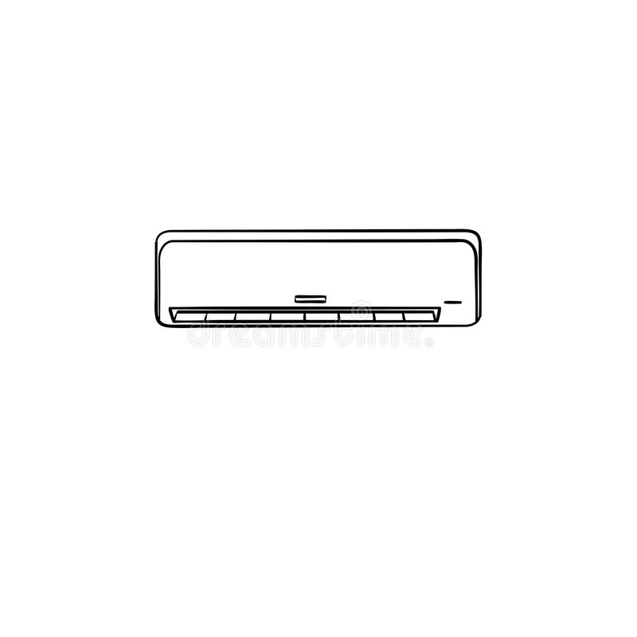

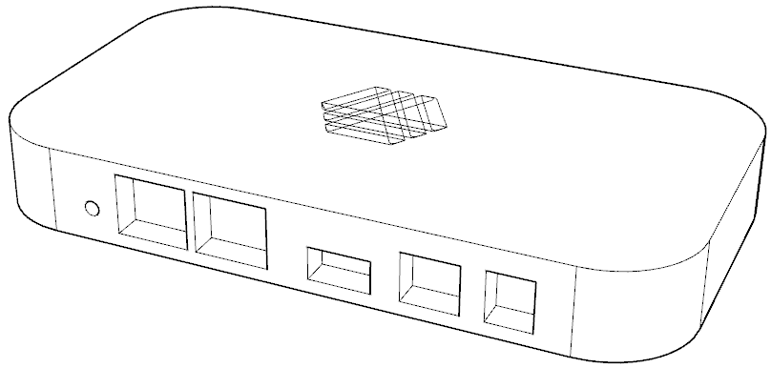
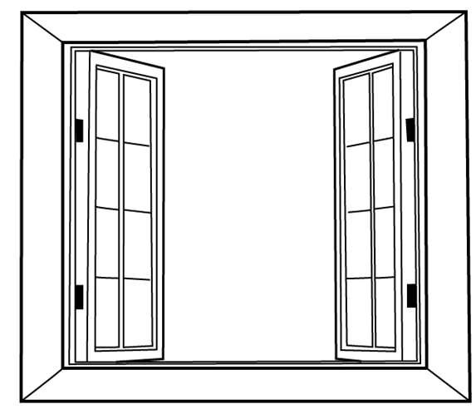
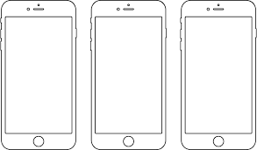

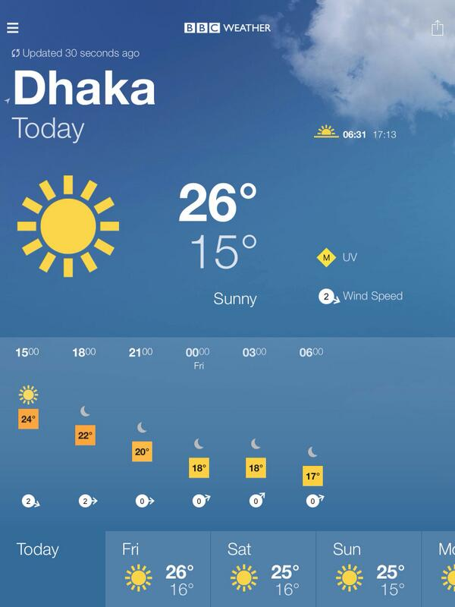

AC Turned off
Smart app showing
the weather is good
Window open

Slide 22
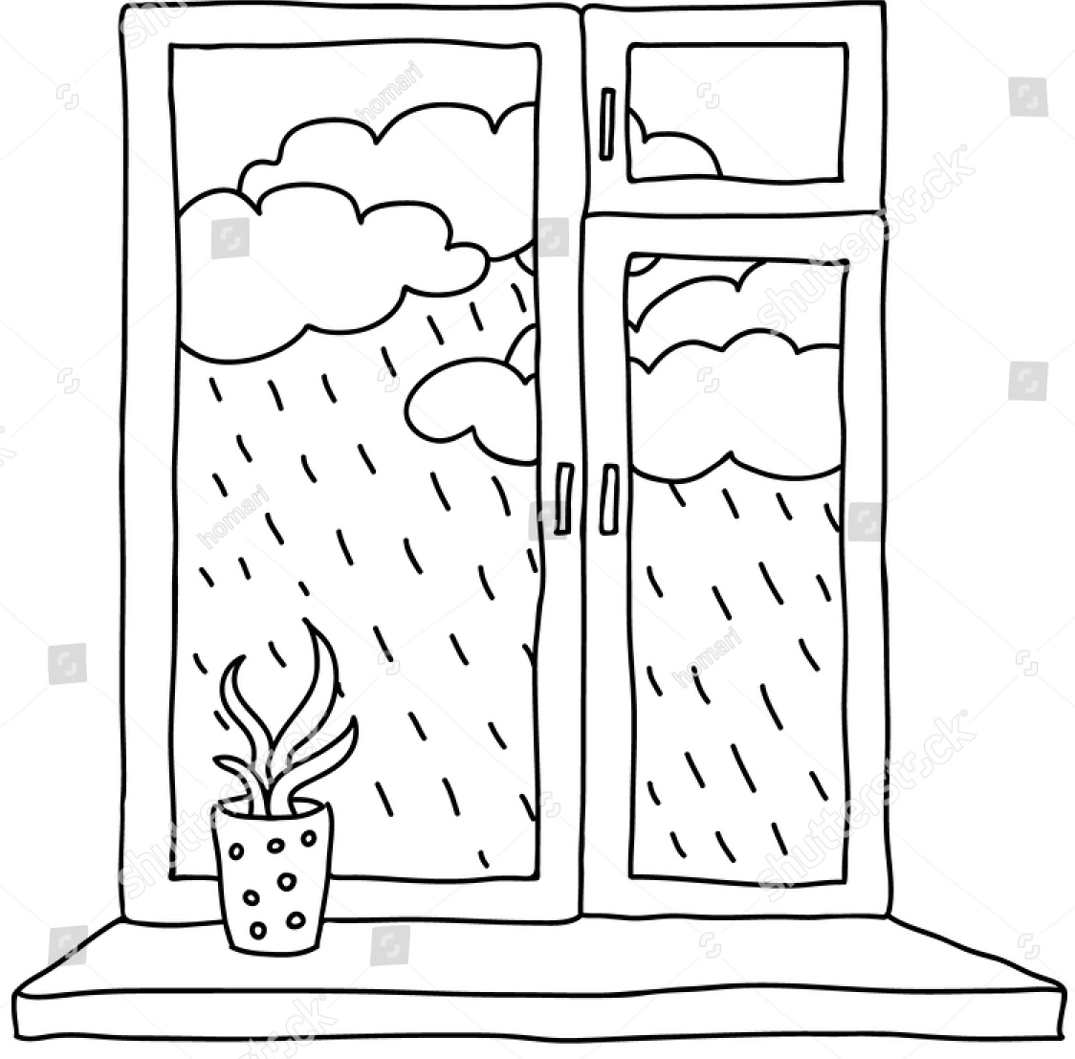
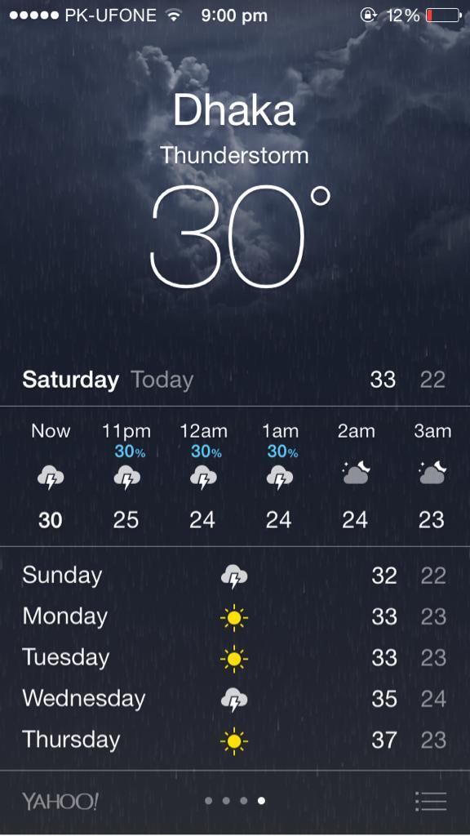
Smart app showing
the weather is rainy
Window automatically closes when the it detects a forecast of rain.

Slide 23
Smart Gardening:
A separate space for garden in the house for the plant lovers. The smart home will allow devices like GreenSens to be compatible with it, keeping the user constantly updated about the health of each of the plants in the garden.
Requirements: GreenSens, Space in the house.

Slide 24
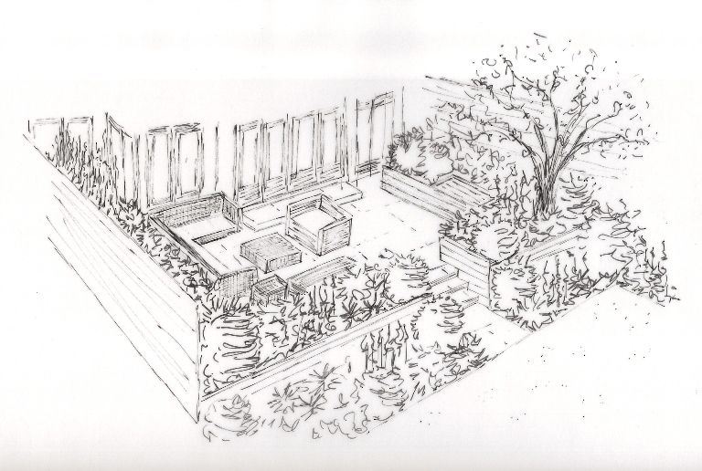

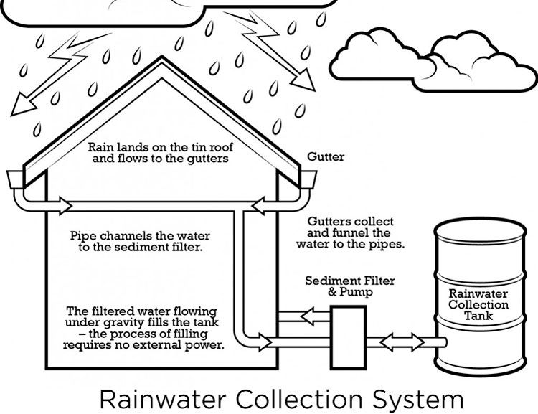
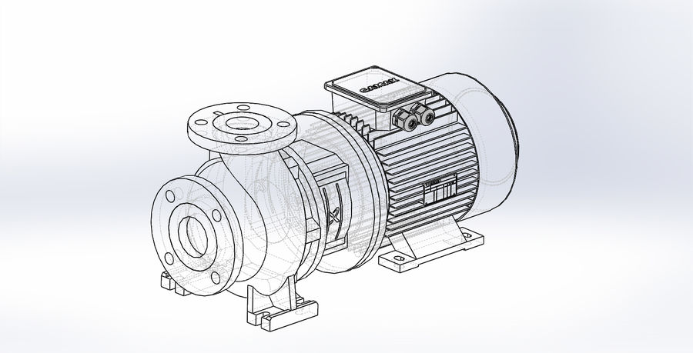
Garden in the terrace and lawn
Smart app showing overall health of plants
When the water level of plants is low, the smart system automatically pumps water to the garden.

Slide 25
Gas Leakage:
Generally in our region, we are highly dependent on gas-controlled stoves. This is, indeed, very dangerous. To make a safer environment in the house, our smart home will include a gas leakage system. This system will generally keep track of gas level in the kitchen vicinity. Once the gas level in the kitchen is more than usual, or out of control, the system will take precautionary measures, such as an alarm system will go off, shutting off the gas flow and on user preference, the windows might open.
Requirements: Gas sensor, alarm system, Micro-controller.

Slide 26

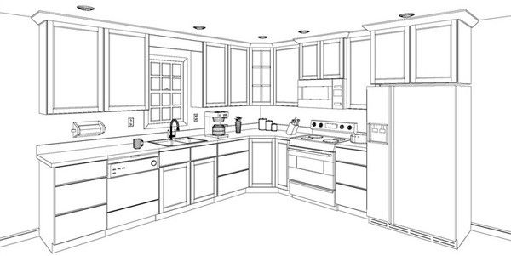
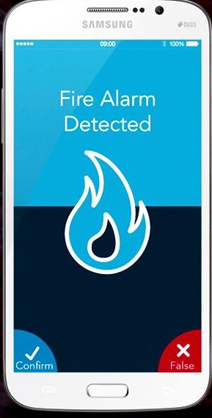
Gas sensors
Fire alarm
Gas level in the kitchen is too high, sending off an alarm and notifications in the app.

Slide 27
Rain water-recycling system:
Luckily, our region has rainy seasons. While this is a real problem, but can also be used to our benefits. Our smart home can store the excess rain water by strategical planning throughout the house, and recycle them; e.g. by purifiying the water or use them in the smart gardening system.
Requirements: Water reservoirs, filter system, waterpumps.

Slide 28
Garden
Primary reservoir water level is low
Primary reservoir

Slide 29
Voltage stabilizers:
Power outage is a real problem in our region, and hence the supply of stable voltages. Since the smart home is electricity-dependent, this is a huge problem. To tackle this, we can integrate stabilizers in our smart home systems to ensure a stable supply of voltages to our electrical appliances. When the stabilizer is not able to handle high voltages, it will send a notification to the user. Requirements: Stabilizers.

Slide 30

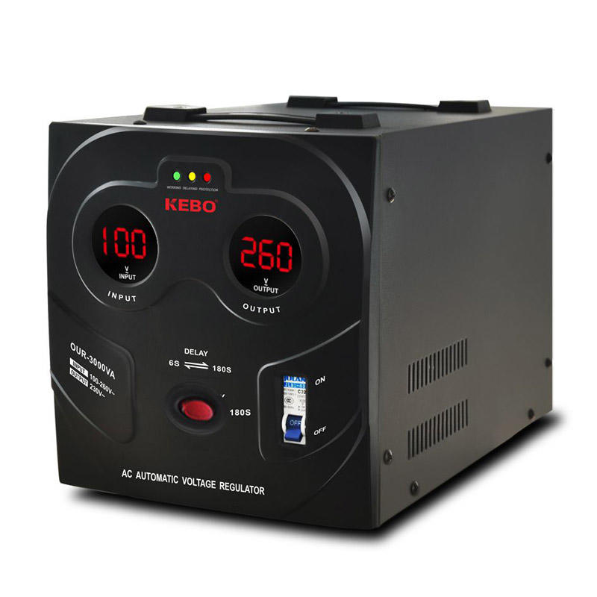
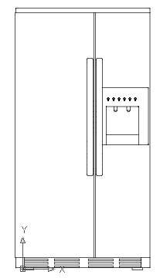
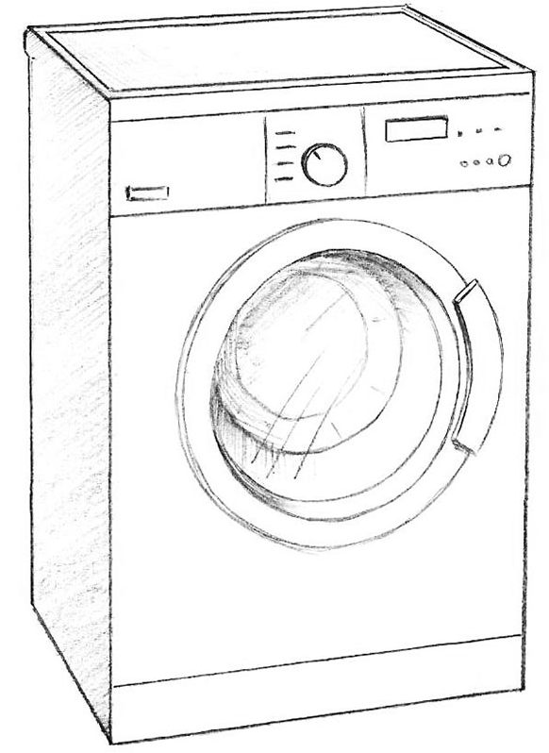
Stabilizer is functioning

Slide 31
Insect Repellers:
Our region is also very prone to insects, especially mosquitoes. Our smart home will include a central system to kill insects, or drive them away. This can be controlled by activating some insect-repelling devices and closing the windows at specific times of a day to keep the insects at bay.
Requirements: Ultrasonic pest repellent.

Slide 32
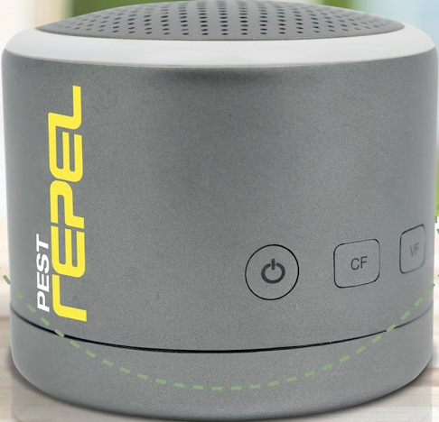
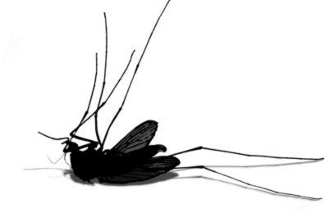
Pest Repel is fucntioning
Pest Repel controlled by the hub

Slide 33
Lightning Rods:
Lightnings are a common phenomenon in our region. In fact, very few houses have precautions to this. So as a precaution, we can use lightning rods to direct the lightning to the ground. So, the smart system can activate the lightning rod, when it can foresee thunderstorms. Requirements: Smart ESE lightning rod (ESE28)

Slide 34
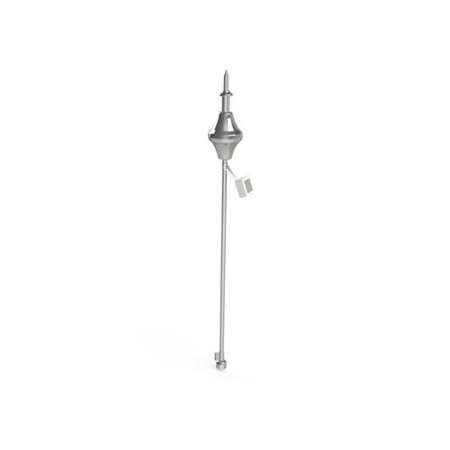
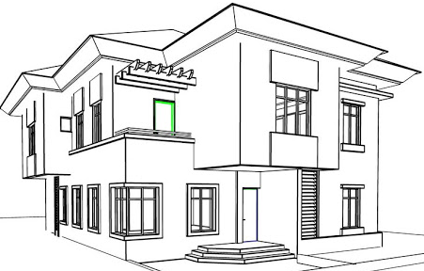
Lightning Rod
Lightning rod activated when it foresees thunderstorm.

Slide 35
Thank you!

